Slide 1
KConnect
FULLSTACK+ML
MRS.ANSHULA GUPTA SHIVI SAXENA-1900290120110
SANDHYA SINGH-1900290120099
SAKSHEE VARSHNEY-1900290120094

Slide 2
INTRODUCTION
KConnect will work as a networking platform for students and alumni of a particular organization.
This platform will help students to interact with seniors and colleagues.
Solve queries regarding placements, interactive clubs, curriculum, projects and many more.
Making necessary updates and announcements.

Slide 3
AIM OF THE PROJECT IS TO…
Provide a platform for juniors to interact with seniors
Doubt clearing conversation between peers
Connecting with alumni
Solve placement queries
Discussion regarding interview experiences

Slide 4
Technologies Used
MONGODB
EXPRESS.JS
REACT
NODEJS
HTML
CSS
BOOTSTRAP

Slide 5
Features of KConnect
Home page - Including a search bar, a repeating group of community questions, and any relevant navigation menus.
User profiles - A page where your users can access and update their information.
A page where users can submit questions.
A page to host each unique question - This will include the question itself, community answers, and a section for users to contribute their answers.
A separate tab for displaying announcements regarding upcoming opportunities and events.
Notification feature for new question updates.
Use of machine learning to detect similar questions.

Slide 6
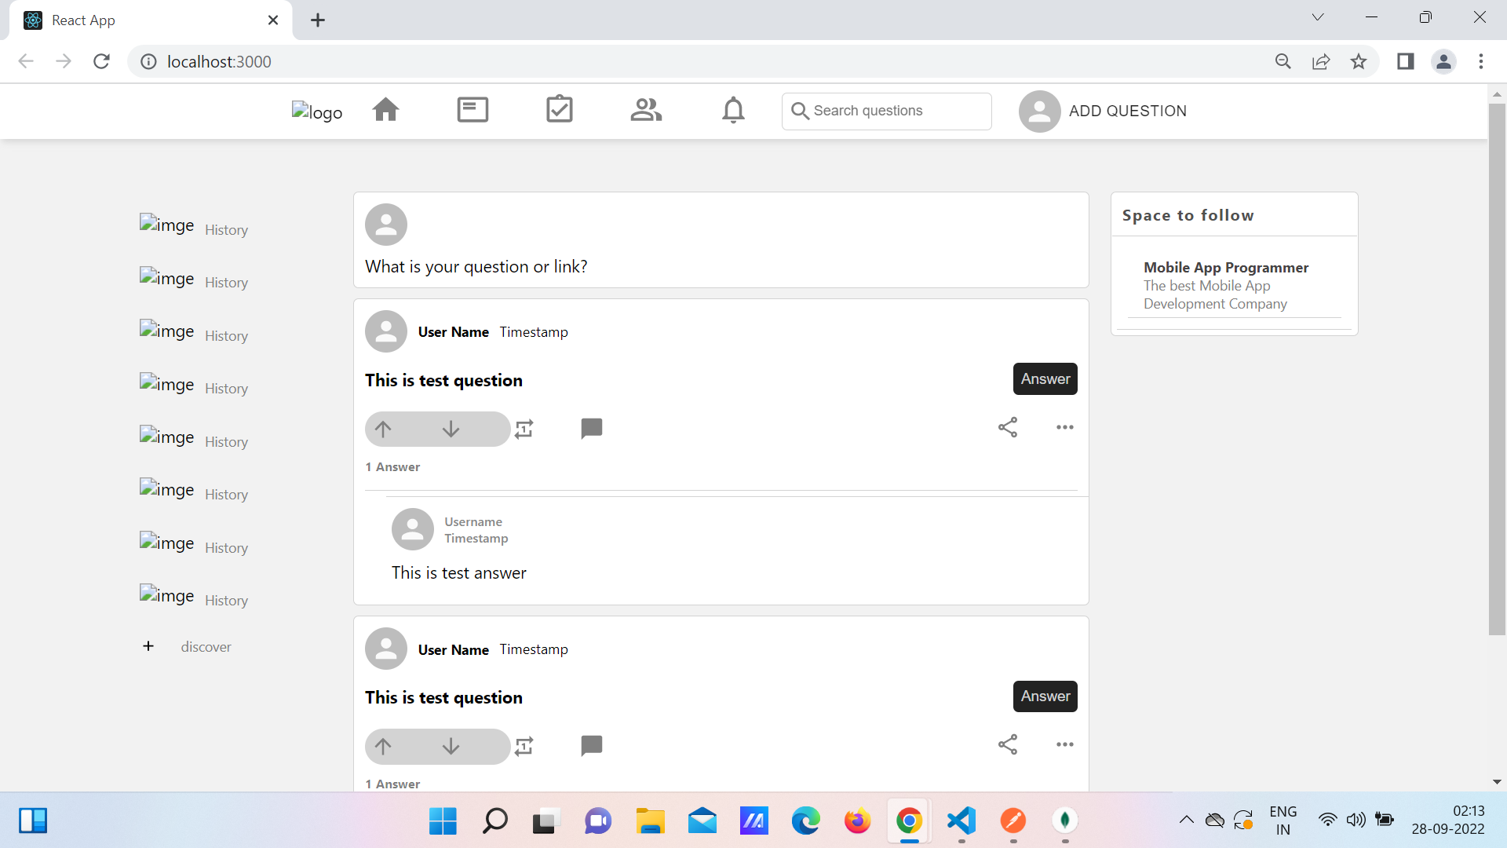


Slide 7
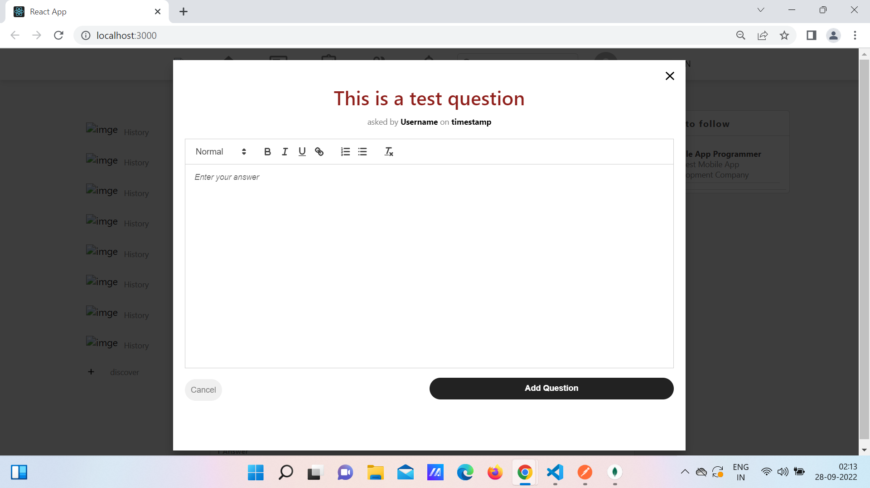

Slide 8
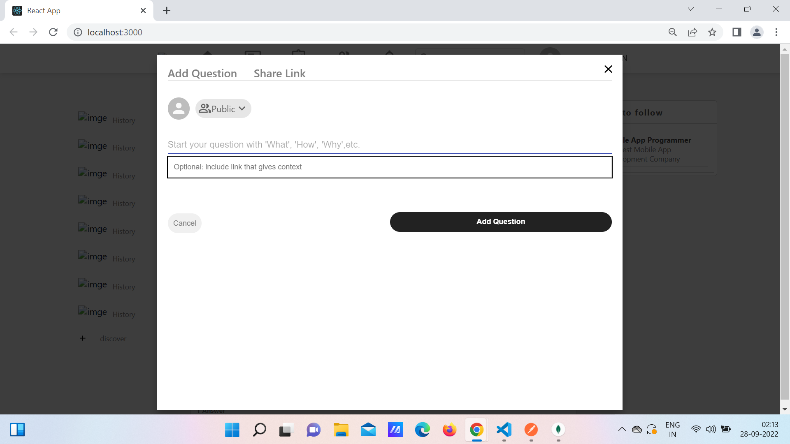

Slide 9
THANK YOU

